Slide 1

South Texas College Brand
Mark Mastej and Alejandra Navarro
January 29, 2019

Slide 2
PART ONE: INTRODUCTION

Slide 3
BRAND: WHAT IT IS NOT
It is NOT a new “theme” or tagline
It is NOT disposable
It is NOT shifting
It is NOT “The Emperor’s New Clothes”

Slide 4
BRAND: WHAT IT IS
The “best self” of South Texas College
The perception of South Texas College and its programs in the minds of the public
It is the link between how South Texas College
is perceived now… and how you want to be perceived in the future

Slide 5
WHY A BRAND?
A strong brand creates, maintains, or extends:
A strong sense of purpose, of identity and of expectation
with the public
An emotional “bank account”
A leadership position in the battle for students and funding
A desire for others to experience your brand

Slide 6
PART TWO: PROCESS

Slide 7
RESEARCH GOALS
Uncover a brand for South Texas College that differentiates it from competitors
Position South Texas College as a leader in higher education
Uncover a brand that unifies all of your programs and services under a single umbrella
Define a campaign approach and language that represents what South Texas College is to all audiences: students, lifelong learners, parents, the community, and business, as well as graduates, faculty and staff

Slide 8
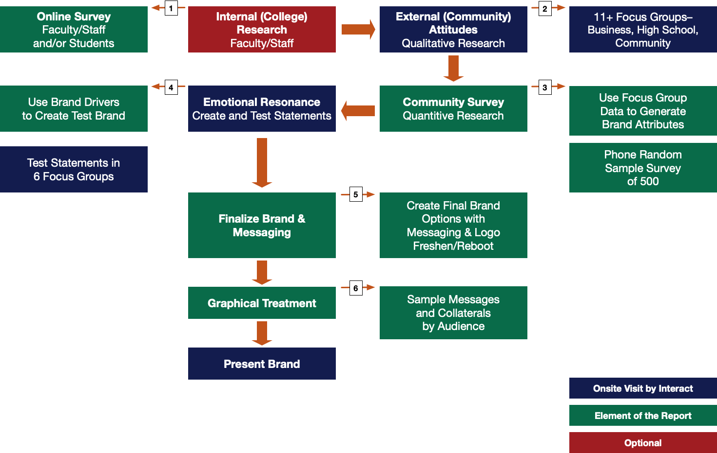
BRAND PROCESS

Slide 9
PHASE 1: QUALITATIVE

Slide 10
ATTRIBUTE DISCOVERY
PHASE 1: QUALITATIVE
Attribute Discovery Focus Groups (11) & Interviews (5)
Business and Industry Professionals – Palm View Golf Course
Community Members and Student Ambassadors – Starr County Campus
Current Students – Pecan Campus
Current Students – Mid-Valley Campus
Faculty and Staff – Pecan Campus
High School Counselors – Pecan Campus
High School Dual Credit Students – Jimmy Carter Early College High School
High School Dual Enrollment Students – Starr County Campus
High School Students – Sharyland High School
Parents – Hidalgo High School (Spanish)
Parents – Pecan Campus
5 Interviews with Board Members

Slide 11
PHASE 2: QUANTITATIVE

Slide 12
ATTRIBUTE TESTING
PHASE 2: QUANTITATIVE
Attribute Test
500 Community Members via Phone Survey
Distributed Over South Texas College Area within Hidalgo and Starr Counties

Slide 13
PHASE 3: TEST STATEMENTS

Slide 14
BRAND TESTING
PHASE 3: TEST STATEMENTS
Brand Testing Focus Groups (6)
Continuing Ed Students
High School Students
Current Students
Faculty & Staff
Community & Business
PR & Marketing Staff

Slide 15
PHASE 4: CREATIVE

Slide 16
INTEGRATE FINDINGS
PHASE 4 CREATIVE
Create a brand statement & campaign slogan that “rings true”
Create a statement that targets both beliefs (logical) and
wants (emotional)
Create a statement that will work with your diverse audiences

Slide 17
THE PROCESS COMES TO LIFE FOR SOUTH TEXAS COLLEGE

Slide 18
Themes and Ideas Discovered in Focus Groups
  Building local economy
  Positive impact on economic and social mobility of community
  A sign of progress in the Rio Grande Valley (though UT-RGV owns the RGV identity)
  Targeting the needs of the community
  Empowering community residents with knowledge
  Networks of people; Connections to jobs
  Pioneer in Education in South Texas
  Challenging and intentional curriculum to prepare for future
  Access to free services to help them be successful
  (including counseling, transportation, computer labs, library, tutoring)
  Catalyst for change
  STC helps students and families move forward
  Breaking barriers; creating a college-going culture

Slide 19
Attributes Developed for Testing
    Collaborative
    Community-centered
    Improving
    Liberating
    Opportunities
    Partnerships
    Pioneering
    Redefining Expectations
    Responsive
    Starting Point
    Student-focused
    Supportive
    Welcoming

Slide 20
TESTED ATTRIBUTES RESULTS
Notes:
- This graph shows the attribute ownership, or how much STC “owns" the attribute in relation to its competition
- The higher the number, the more the concept was attributed to STC instead of its competition, meaning they “owned” it
- Attributes were developed from the first round of focus groups and tested in the phone survey

Slide 21
TESTED ATTRIBUTES RESULTS
Notes:
- This graph shows how the attribute ownership differs by age group
- Each color bar relates to how a specific attribute (by color) was “owned” by STC in the opinions of the corresponding age group
- Negative ownership scores indicate that for those attributes, STC’s competition owned the attribute more than
- Each attribute is rated different age groups differently, which may be used in fine-tuning messaging for specific audiences

Slide 22
TESTED ATTRIBUTES RESULTS
Notes:
Starr County has a much smaller population, so we had a much smaller population in the sample –6.8 percent of the surveyed population

Slide 23
TESTED ATTRIBUTES RESULTS

Slide 24
TESTED ATTRIBUTES RESULTS

Slide 25
ATTRIBUTE OWNERSHIP
Best-Tested Attributes “Owned” by South Texas College
Community-centered (0.369)
Supportive (0.294)
Opportunities (0.277)
Improving (0.245)
Starting Point (0.238)
Welcoming (0.209)

Slide 26
ATTRIBUTE OWNERSHIP
Ownership, But Not Strong
Student-focused (0.167)
Redefining Expectations (0.163)
Responsive (0.160)
Collaborative (0.152)
Little Differentiation with Competition
Partnerships (0.128)
Liberating (0.099)
Pioneering (0.096)

Slide 27
CORE CONCEPTS
Well-Tested Attributes Become the Core Concepts and Are Building Blocks for Test Statements
  Community-Centered
  Opportunities in a Welcoming and Supportive Environment
  Improving / STC is Growing with the Region

Slide 28
STATEMENTS BUILT
Test Statements:
Test statements are simple
They are disposable
They test the emotional components of words
Meant to be imperfect

Slide 29
TESTED STATEMENTS
  Opportunities in a Welcoming and Supportive Environment
Experience Opportunities
Here for You
Promise
We’re Family
  Community-
  Centered
A College Community
South Texas Proud
STC Guaranteed
Together
Improving / STC is Growing with the Region
Empowering Growth
Expects More
Involved Beyond
Stepping Up

Slide 30
TESTED STATEMENTS
STC Brand Test Part 1 Ranking
Chosen Brand Concepts By Overall Audience
Overall Rank | Statement | Mean Rating 1-6 scale (>3.500 = positive)
1st | Empowering Growth | 5.073
2nd | Experience Opportunities | 4.992
3rd | Here for You | 4.967
4th | South Texas Proud | 4.953
5th | We’re Family | 4.716
6th | A College Community | 4.562
7th | Together | 4.496
8th | Promise | 4.266
9th | Involved Beyond | 4.203
10th | STC Guaranteed | 3.976
11th | Stepping Up | 3.877
12th | Expects More | 3.662

Slide 31
HIGHEST RATED
TEST STATEMENTS
Empowering Growth
Experience Opportunities
Here for You
South Texas Proud
We’re Family
A College Community
Together

Slide 32
POWER WORDS
Accessible
Advantage
Augment
Benefit
Beyond
Caring
Careers
Challenging
Choice
Connection
Collaboration
Comfortable
Community
Connection
Convenient
Customized
Elevated
Empowering
Engaging
Enjoyable
Expanding
Experience
Family
Flexible
Friendly
Future
Growth
Hands-on
Helpful
Hospitality
Inclusive
Integrated
Inviting
Involved
More
Motivating
One-on-one
Opportunities
Options
Partnerships
Pathway
Personal
Practical
Prepared
Promise
Prosper
Quality
Resource
Respectful
Responsive
Results
Sharing
Solid
Stepping Up
Succeed
Supportive
Together
Underestimated
Understanding
Welcoming

Slide 33
BRAND PROVENANCE
Focus Groups
Collaborative
Community-centered
Improving
Liberating
Opportunities
Partnerships
Survey
Community-centered
Improving
Opportunities
Starting Point
Supportive
Welcoming
Brand Test
Community-Centered
Improving/STC Growing in the Region
Opportunities in a Supportive and Welcoming Environment
Pioneering
Redefining Expectations
Responsive
Starting Point
Student-focused
Supportive
Welcoming

Slide 34
THE AUDIENCES
TIER 1
Personal
Potential Students — Your Entrance to Job or
Transfer
Families — Education within Research
Faculty and Staff
Communities — Focused on Community Needs
Business and Industry — Responsive to Training Needs
Leadership — An Engine for Growth
Regional — A Resource for Change
TIER 2
Societal
TIER 3
Governmental

Slide 35
SOUTH TEXAS COLLEGE BRAND
Top Attribute “Areas”
Community-Centered – Creating a new standard, serving all facets of the community
Opportunities – Student success, student involvement
Supportive – Welcoming, with many layers of services to help students and families succeed

Slide 36
SOUTH TEXAS COLLEGE BRAND
South Texas College is…
An outstanding – and constantly improving – destination for career education
A warm and welcoming college community
A place that connects businesses with tech-savvy talent
A source of unprecedented opportunities
Above all, South Texas College represents a unique and empowering experience
To experience STC… is to Experience Exceptional.

Slide 37
Notes:
Add graphic

Slide 38
SOUTH TEXAS COLLEGE BRAND
Experience Exceptional.
“Experience” is an intriguing, versatile concept with broad relevance to overall college attendance, as well as the individual endeavors, events, practices and struggles of a college student.
It represents the “action” half of the wordmark, while providing an engine for dynamic messaging.
Meanwhile, “Exceptional” combines the attributes of “originality” and “excellence” in an elegant, versatile word that pairs well with experience.

Slide 39
SOUTH TEXAS COLLEGE BRAND
Why It Works
Together, Experience Exceptional forms a strong, “built-in call-to-action” wordmark
It builds on the idea that STC is more akin to a community of higher learning than a continuation of high school.
Substituting the acronym “STC” in the wordmark — “Experience STC” — makes it a dynamic call to action

Slide 40
SOUTH TEXAS COLLEGE BRAND
Why It Works
In Spanish, the analogous phrase “Una Experiencia Excepcional” forms an elegant wordmark, should the college choose to translate. The word mark is similar enough in Spanish that it can also be left in English and understood.

Slide 41
SOUTH TEXAS COLLEGE BRAND
Finally….
No one else has it
It is simple
It encompasses STC’s unique attributes
It’s infinitely flexible

Slide 42
CAMPAIGN CONCEPT
“Exceptional _______”
Exceptional Faculty
Exceptional Training
Exceptional Support
Exceptional Futures
Exceptional Graduates

Slide 43


SAMPLE ADS
PROSPECTS

Slide 44
SAMPLE ADS
PROSPECTS

Slide 45

SAMPLE ADS
PROSPECTS

Slide 46
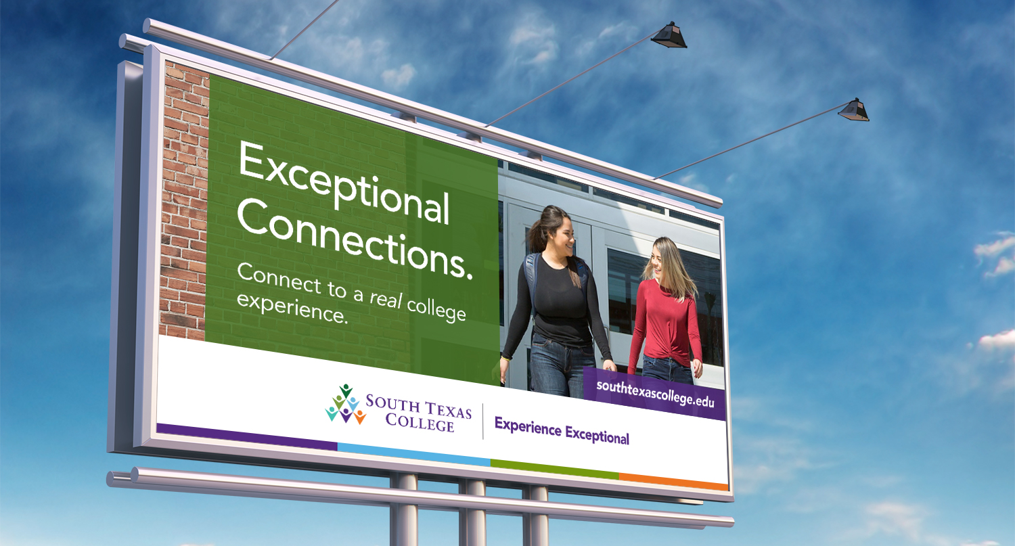
SAMPLE ADS
PROSPECTS

Slide 47

SAMPLE ADS
EMPLOYERS (Business & Industry)

Slide 48

SAMPLE ADS
EMPLOYERS (Business & Industry)

Slide 49

SAMPLE ADS
EMPLOYERS (Business & Industry)

Slide 50

SAMPLE ADS
EMPLOYERS (Business & Industry)

Slide 51
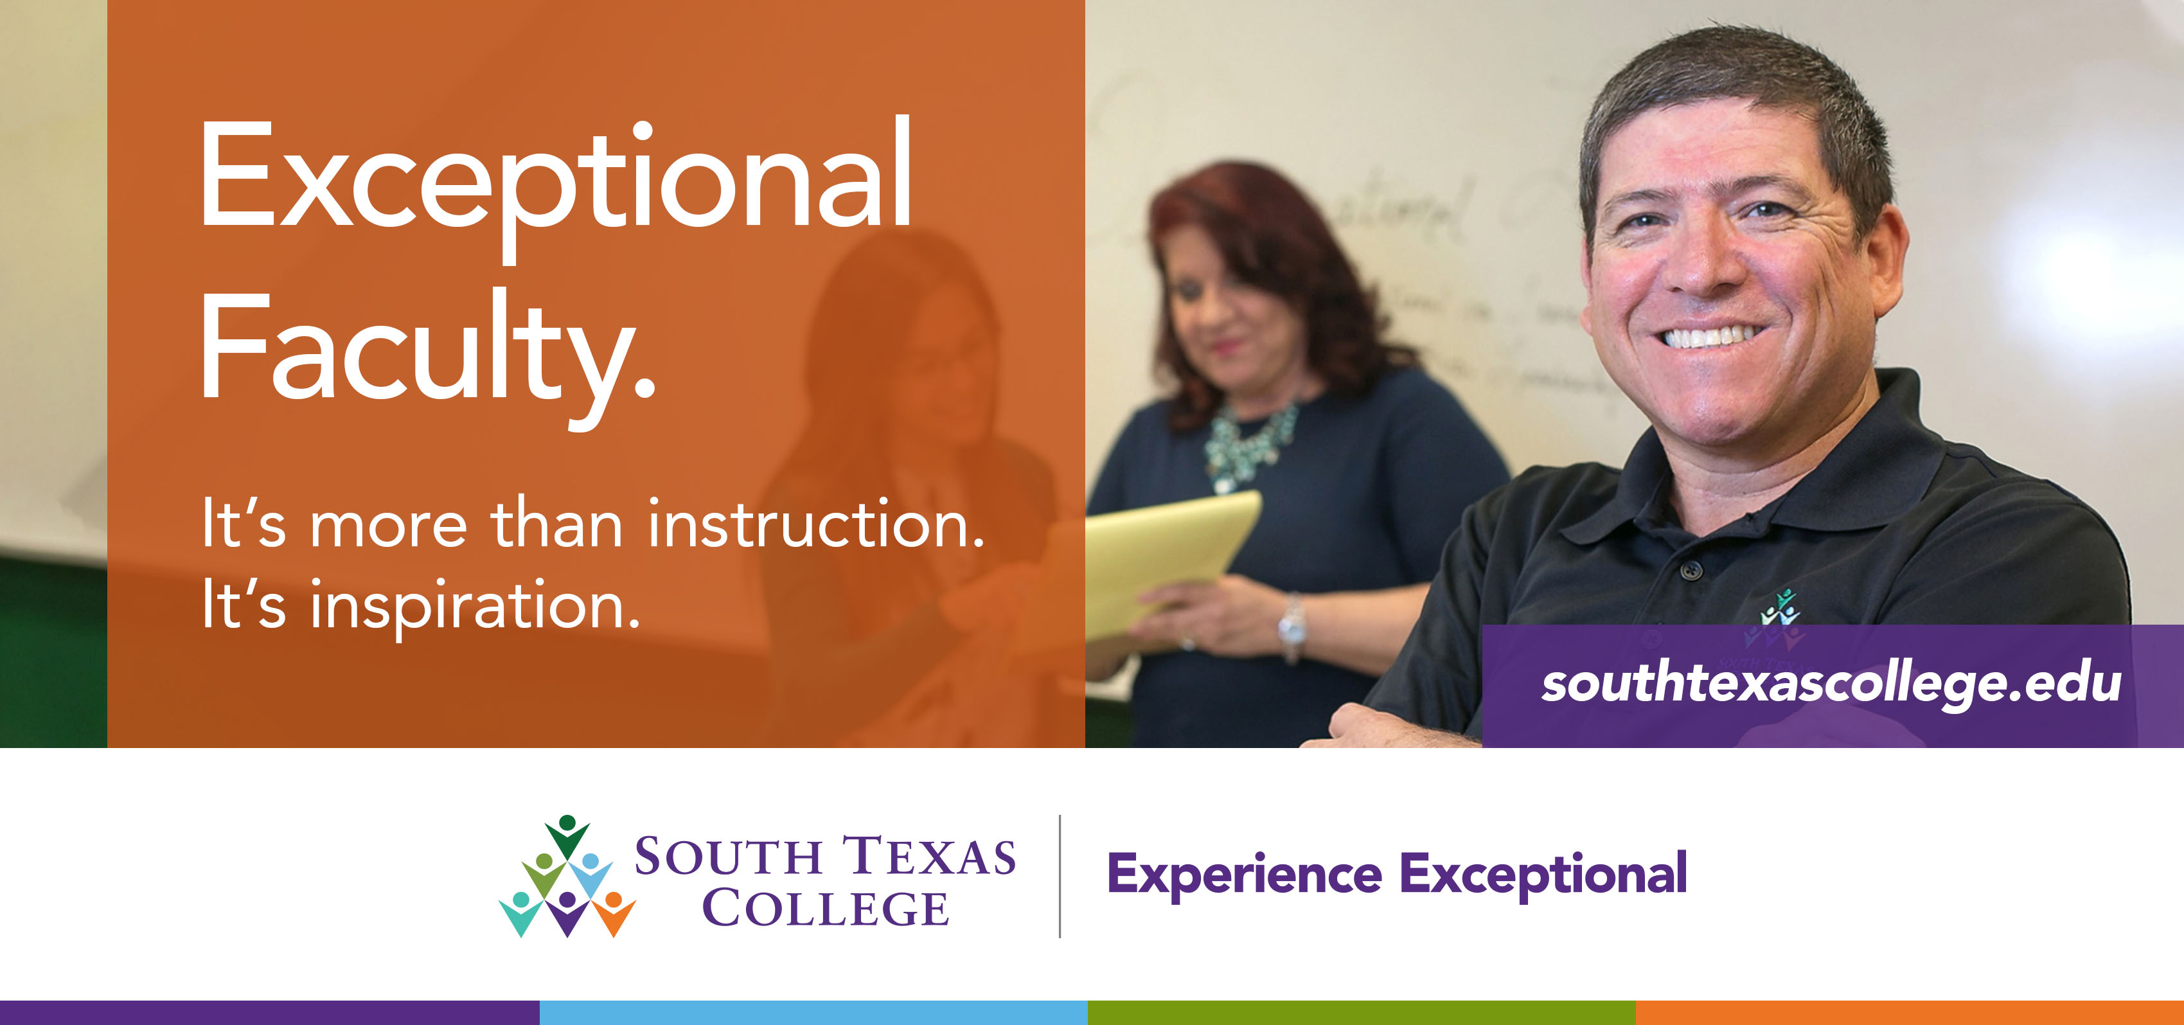
SAMPLE ADS
INTERNAL (Faculty, Staff, Leadership)

Slide 52
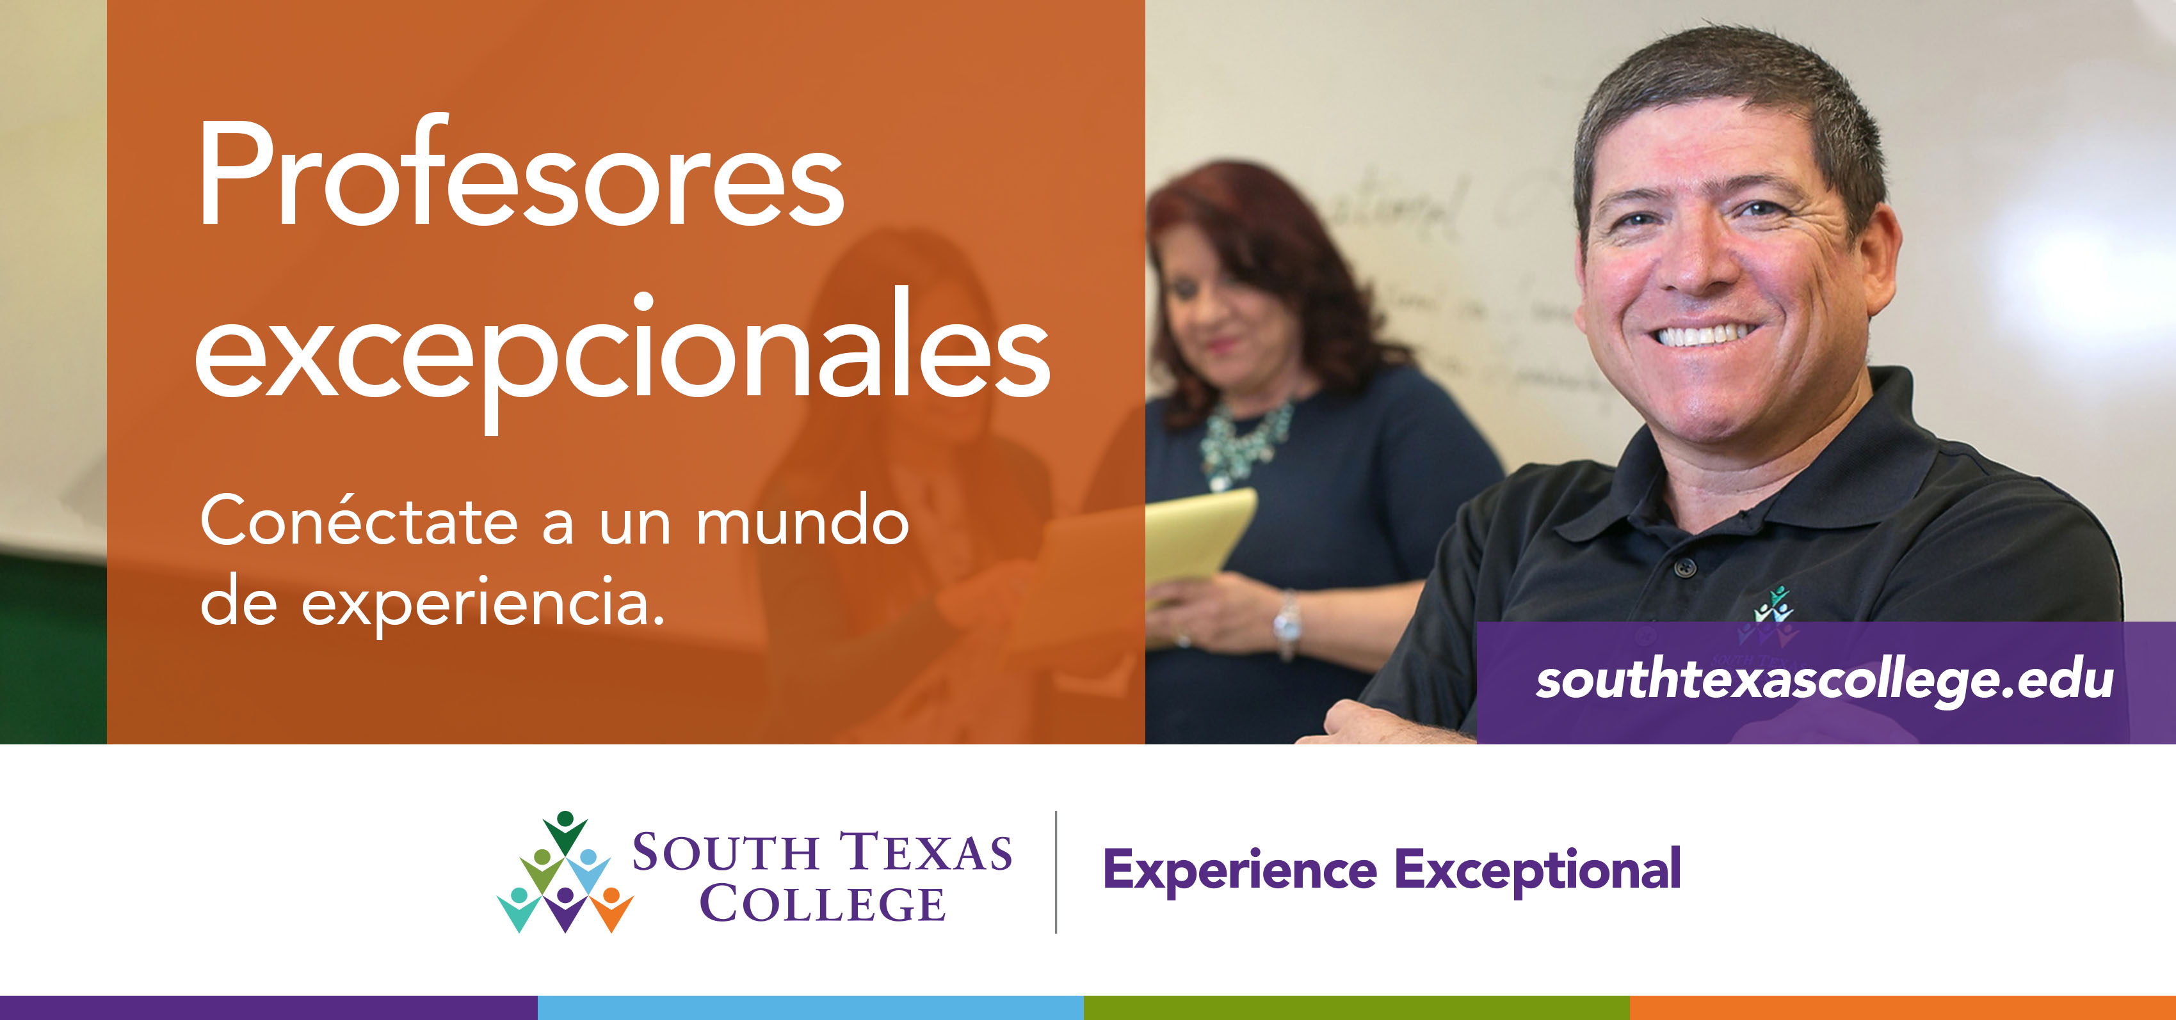
SAMPLE ADS
SPANISH

Slide 53

SAMPLE ADS
COMMUNITY

Slide 54
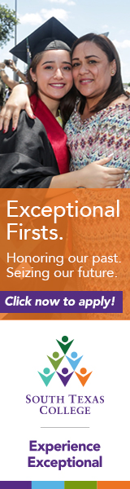


SAMPLE ADS
COMMUNITY (WEB)

Slide 55
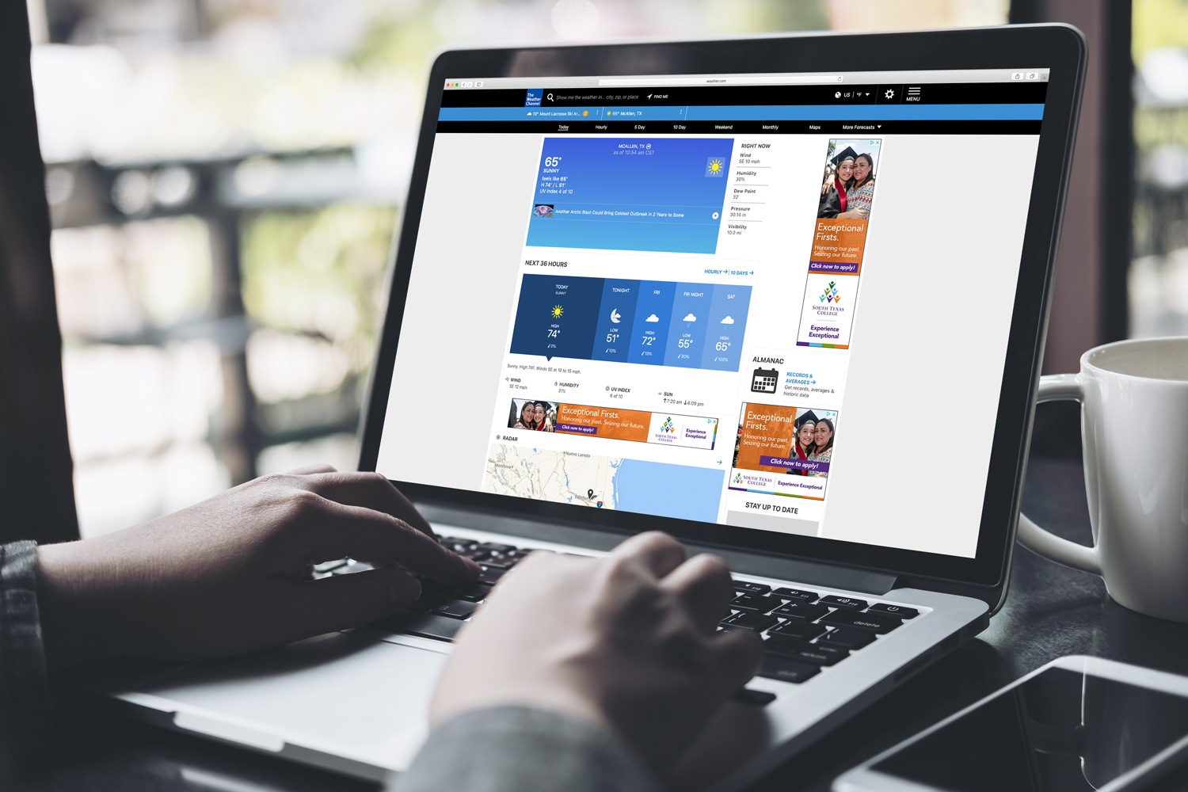
SAMPLE ADS
COMMUNITY (WEB)

Slide 56
CAMPAIGN CONCEPT
“Experience _______”
Experience STC (Student Life)
Experience Bigger Paychecks (General)
Experience IT (IT-related fields)
Experience Innovation (STEM-related fields)
Experience Life in 3D (Advanced Manufacturing)

Slide 57

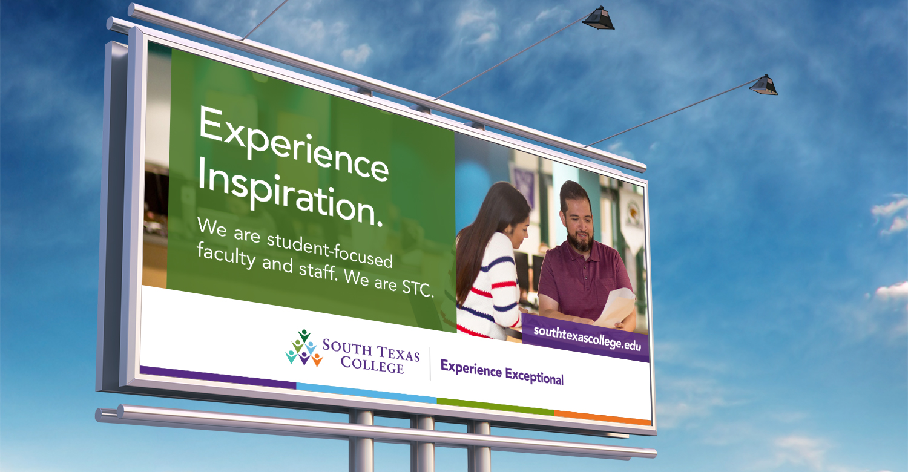
CAMPAIGN CONCEPT

Slide 58
CAMPAIGN CONCEPT

Slide 59

CAMPAIGN CONCEPT

Slide 60
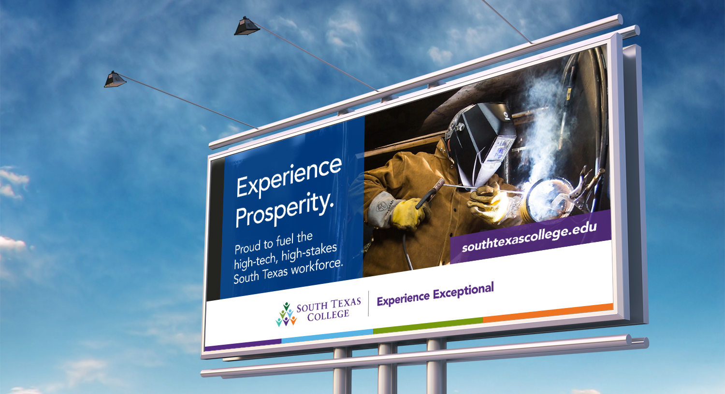
CAMPAIGN CONCEPT

Slide 61
FLEXIBLE AND CUSTOMIZABLE
“Experience Exceptional” is endlessly flexible and customizable.
The following represent just a few ideas for post-launch campaigns advancing the “Experience Exceptional” brand.

Slide 62
ADDITIONAL CAMPAIGN CONCEPTS
”_______Exceptional ______” or “______ an Exceptional ______”
Build an Exceptional Life
Secure an Exceptional Career
Live an Exceptional Life
Discover Exceptional Opportunities
Gain Exceptional Skills
Do Exceptional Work

Slide 63
“I am Exceptional”
For Prospective Students
I am ready to meet my career’s unique challenges.
I am fast, focused, and unfailingly confident in my skills.
I am experience-tested, workforce ready, and recession-proof.
I am Exceptional.

Slide 64
CAMPAIGN CONCEPT
“The STC Experience”
Notes:
A broad concept used to tell individual student and alum success stories, and to introduce focused pieces on individual aspects of STC (programs, people, student life, facilities/equipment, cultural events, etc.)

Slide 65
WHAT’S NEXT…

Slide 66
NEXT STEPS
Finalize the Graphical Treatment for brand statement
Finalize the campaign treatment with graphical framework, photography and message algorithm
Prepare for the community rollout
Make it happen!

Slide 67
Notes:
Add graphic

Slide 68

2yearexperts.com

